Slide 1
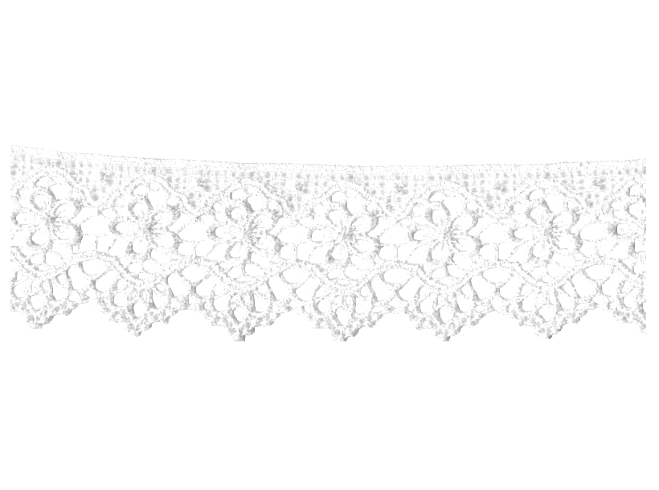

VivINTEL Case
Kofoworola Ogutuga

Slide 2
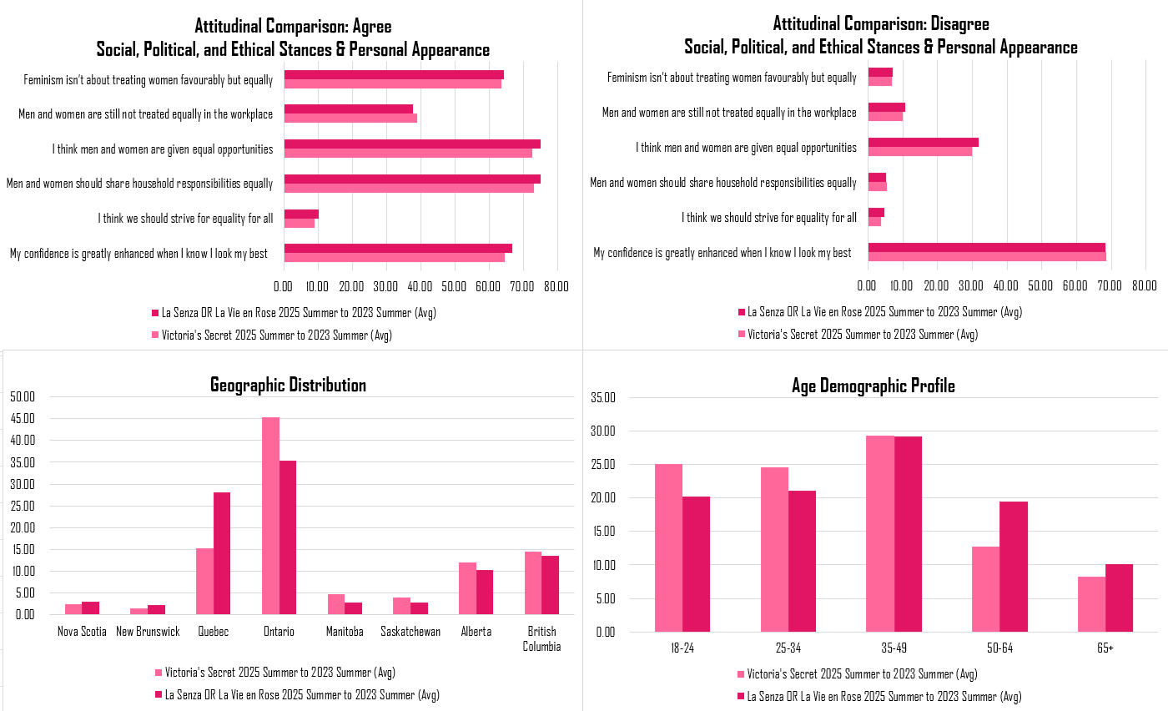
Demographics Comparison
Age: Victoria’s Secret shoppers are more geographically concentrated than competitors, with a stronghold in Ontario ( VS 45.7% vs. Other 35.6% of other shoppers). In contrast, Quebec is underrepresented ( VS 15.5% vs. Other 28.0%). The brand performs relatively better in Manitoba ( VS 4.8% vs. Other 2.7%) and Saskatchewan ( VS 4.0% vs. Other 2.8%), while Alberta ( VS 11.4% vs. Other 10.1%) and British Columbia ( VS 14.3% vs. Other 13.4%) show more balanced shares.
Province: Demographically, Victoria’s Secret appeals to a younger audience, particularly those aged 18–24 ( VS 24.8% vs. Other 20.3%) and 25–34 ( VS 24.4% vs. Other 21.0%), while engagement drops with older consumers. Shoppers aged 50–64 ( VS 13.8% vs. Other 19.6%) and 65+ ( VS 7.6% vs. Other 9.7%) are less represented. Income distribution is mixed, with both lower- and higher-income consumers more likely to shop at Victoria’s Secret than mid-range earners.
Minority Groups: Minority and LGBTQ+ shoppers are also overrepresented, suggesting the brand resonates with diverse and inclusive audiences. South Asian customers have an index score of 212, indicating significant engagement. Intersectional groups such as gay or lesbian Indigenous shoppers aged 18–24 show extremely high representation ( VS index 400), highlighting the brand’s strong appeal among younger and diverse consumers who view Victoria’s Secret positively in terms of identity and inclusivity.

Slide 3
"Me Too" Attitudinal Comparison
Though a big part of Victoria's Secret's branding links appearance with empowerment and confidence, VS shoppers are less likely to agree that “My confidence is greatly enhanced when I know I look my best” (VS: 64.6%, Other: 66.7%). This indicates that the brand’s empowerment angle isn't impacting VS shopper as much as they may have thought. Furthermore, VS shoppers are still ~2% less likely to agree that “we should strive for equality for all"(VS: 8.2%, Other: 10.0%) and that "Men and women should share household responsibilities equally" (VS: 73.1%, Other: 75.0%).
However, a larger proportion of VS shoppers still acknowledge inequality. Agreeing that "Men and women are still not treated equally in the workplace" (VS: 39.0%, Other: 37.5%) and are less likely to agree that "men and women are given equal opportunities" (VS: 72.8%, Other: 75.0%). This acknowledgement might be the work of the “Me Too” movement. During "Me Too" many victims of workplace sexual harassment and SA spoke out about the inequalities woman in the workforce are forced to silently smile through. We believe VS shopper acknowledge workplace inequality unlike general inequality, because of "Me Too".
But somehow, both groups show nearly identical agreement on the core definition that “feminism isn’t about treating women favorably but equally" (VS: 63.7%, Other: 64.1%). This implies that Victoria's Secret shoppers understand and accept the dictionary definition of feminism as equality, which was a big part of the "Me Too" movement.
This all creates a challenge for Victoria's Secret's rebranding efforts. Their shoppers recognize inequality but disagree with some equality rhetorics, they are also less motivated by appearance-based confidence than VS assumes.

Slide 4
Future Marketing
From this analysis, we would say that Victoria’s Secret shoppers are mostly younger adults and are more likely to care about work inequality. This shows the brand’s audience is socially conscious, so their marketing should highlight inclusivity and empowerment if they want to stay relevant.
  Regional Marketing : Victoria's Secret is missing out on so many potential customers in Québec; they need to campaign with tailored ads locally .
  Specific Age Campaigns: Marketing for 18-34 should evolve with their values, emphasizing inclusivity and authenticity. For the older demographics, product-led messaging focusing on fit, comfort, and quality.
  "Me Too": Even though VS shoppers lean less progressive, many pay attention to how the brand handles workplace culture and representation. Being open about diversity, showing real changes with outside proof (like independent reviews or transparency reports) can build and keep trust.

